Slide 1
Unsupervised Representational Learning with Deep Convolutional Generative Adversarial Networks
Alec Radford, Luke Metz, and Soumith Chintala
CSCI 8360 Lecture 8

Slide 2
Supervised Learning
Learn a function f
Support Vector Machine
Decision Tree
Naïve Bayes
…etc
Training (labeled) data
Where does the labeled data come from?

Slide 3
Unsupervised Learning
Clustering
Connectivity / Hierarchical
Centroid
Density / Distribution
…etc
Does not require training data
Needs some notion of “similarity”

Slide 4
Generative Adversarial Networks (GANs)
Goodfellow et al, 2014

Slide 5
Drawbacks
Training of GANs can be unstable, resulting in nonsensical outputs from the generator network
Limited attempts to visualize and lend intuition for the concepts learned by GANs and their intermediate outputs
Ha

Slide 6
Deep Convolutional GANs
Constraints on the architectural topology of convolutional GANs to guarantee stability in training
Use trained discriminators for image classification tasks, achieving competitive performance with other unsupervised algorithms
Visualize trained filters and empirically demonstrate how they have learned to draw specific objects
Generators have specific vector arithmetic properties allowing for easy manipulation of semantic qualities of generated samples

Slide 8
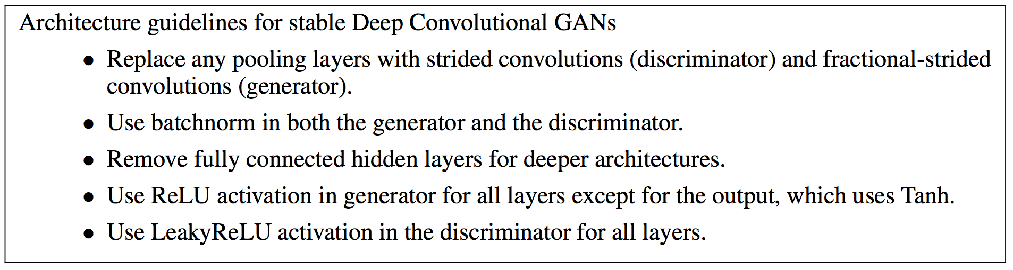
Architecture Changes in DCGANs
Notes:
Historical attempts to scale up GANs using CNNs to model images have been unsuccessful. This motivated the authors of LAPGAN (Denton et al., 2015) to develop an alternative approach to it- eratively upscale low resolution generated images which can be modeled more reliably. We also encountered difficulties attempting to scale GANs using CNN architectures commonly used in the supervised literature.
Batch Normalization
- stabilizes learning by normalizing the input to each unit to have zero mean and unit variance
- helps deal with training problems that arise due to poor initialization and helps gradient flow in deeper models
- proved critical to get deep generators to begin learning, preventing the generator from collapsing all samples to a single point which is a common failure mode observed in GANs
Directly applying batchnorm to all layers however, resulted in sample oscillation and model instability
- avoided by not applying batchnorm to the generator output layer and the discriminator input layer
The ReLU activation is used in the generator with the exception of the output layer which uses the Tanh function
- using a bounded activation allowed the model to learn more quickly to saturate and cover the color space of the training distribution
- in the discriminator we found the leaky rectified activation to work well, especially for higher resolution modeling. This is in contrast to the original GAN paper, which used the maxout activation

Slide 9
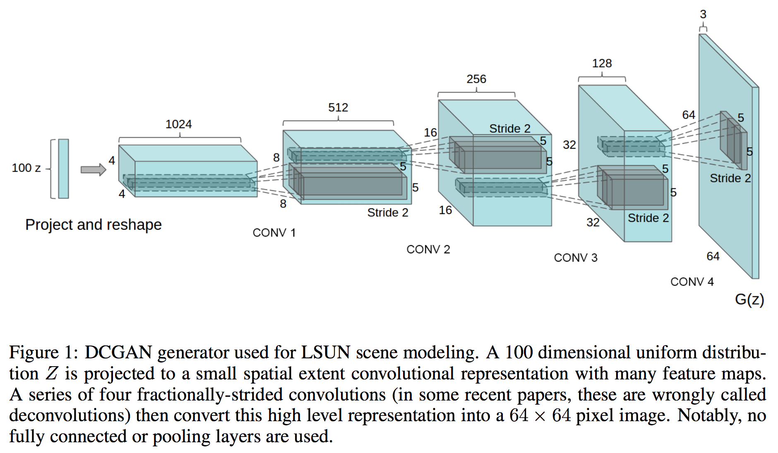
Notes:
Second is the trend towards eliminating fully connected layers on top of convolutional features.
The strongest example of this is global average pooling
- global average pooling increased model stability but hurt convergence speed
A middle ground of directly connecting the highest convolutional features to the input and output respectively of the generator and discriminator worked well
- first layer of the GAN, which takes a uniform noise distribution Z as input, could be called fully connected as it is just a matrix multiplication
- result is reshaped into a 4-dimensional tensor and used as the start of the convolution stack
For the discriminator, the last convolution layer is flattened and then fed into a single sigmoid output

Slide 10
Datasets
Large-scale Scene Understanding (LSUN)
~3M training examples of bedroom images
ImageNet-1K
1K natural images, 32x32 center-cropped
Faces
~3M images from ~10K people
No image preprocessing (oh, aside from scaling range of tanh)
Notes:
3:
- Peoples’ names came from dbpedia
- scraped images from search results of those names

Slide 11
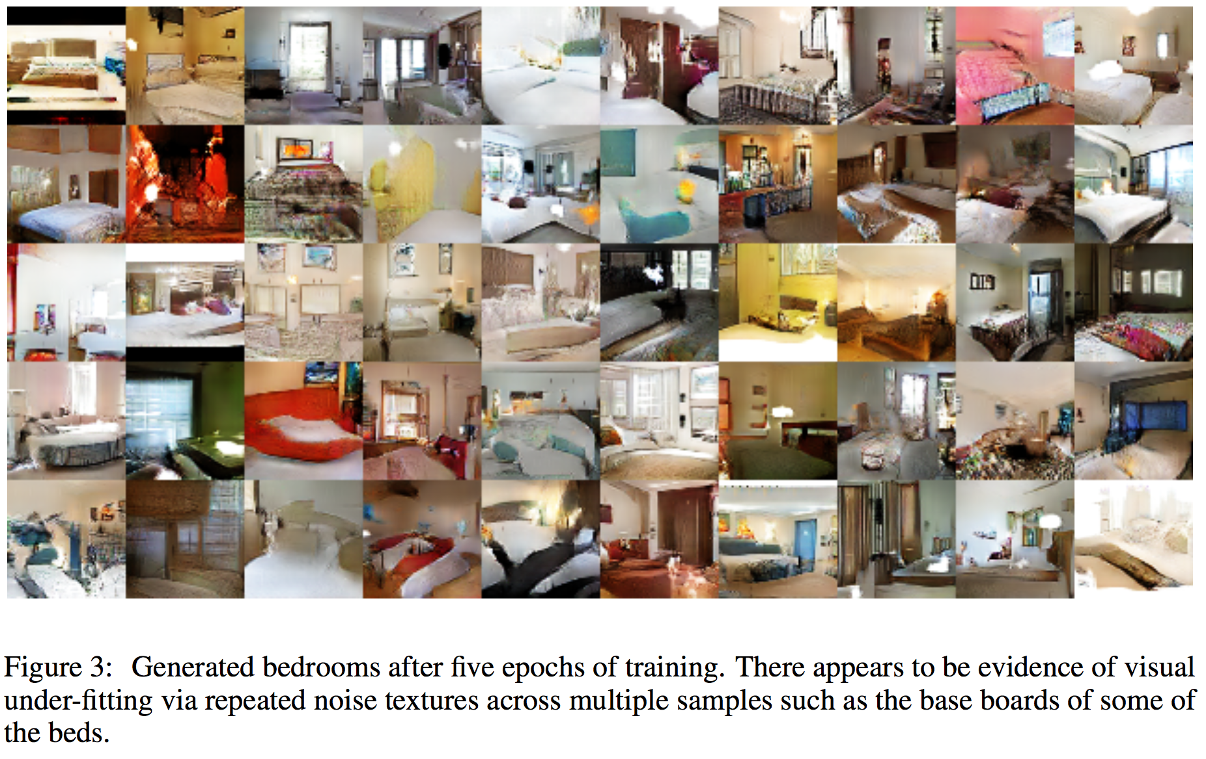

Slide 12
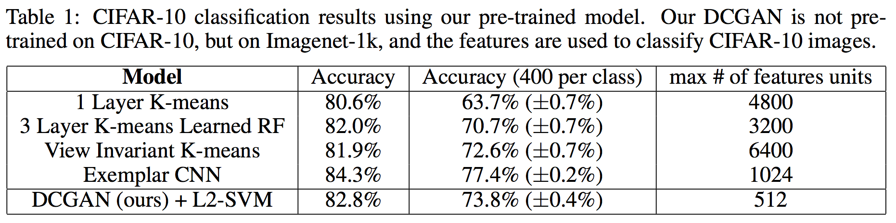
Notes:
On the CIFAR-10 dataset, a very strong baseline performance has been demonstrated from a well tuned single layer feature extraction pipeline utilizing K-means as a feature learning algorithm
When using a very large amount of feature maps (4800) this technique achieves 80.6% accuracy. An unsupervised multi-layered extension of the base algorithm reaches 82.0% accuracy (Coates & Ng, 2011).
We train on Imagenet-1k and then use the discriminator’s convolutional features from all layers, maxpooling each layers representation to produce a 4 × 4 spatial grid. These features are then flattened and concatenated to form a 28672 dimensional vector and a regularized linear L2-SVM classifier is trained on top of them. This achieves 82.8% accuracy, out performing all K-means based approaches
Notably, the discriminator has many less feature maps (512 in the highest layer) compared to K-means based techniques, but does result in a larger total feature vector size due to the many layers of 4 × 4 spatial locations. The performance of DCGANs is still less than that of Exemplar CNNs (Dosovitskiy et al., 2015), a technique which trains normal discriminative CNNs in an unsupervised fashion to differentiate between specifically chosen, aggressively augmented, exemplar samples from the source dataset. Further improvements could be made by finetuning the discriminator’s representations, but we leave this for future work. Additionally, since our DCGAN was never trained on CIFAR-10 this experiment also demonstrates the domain robustness of the learned features.

Slide 13
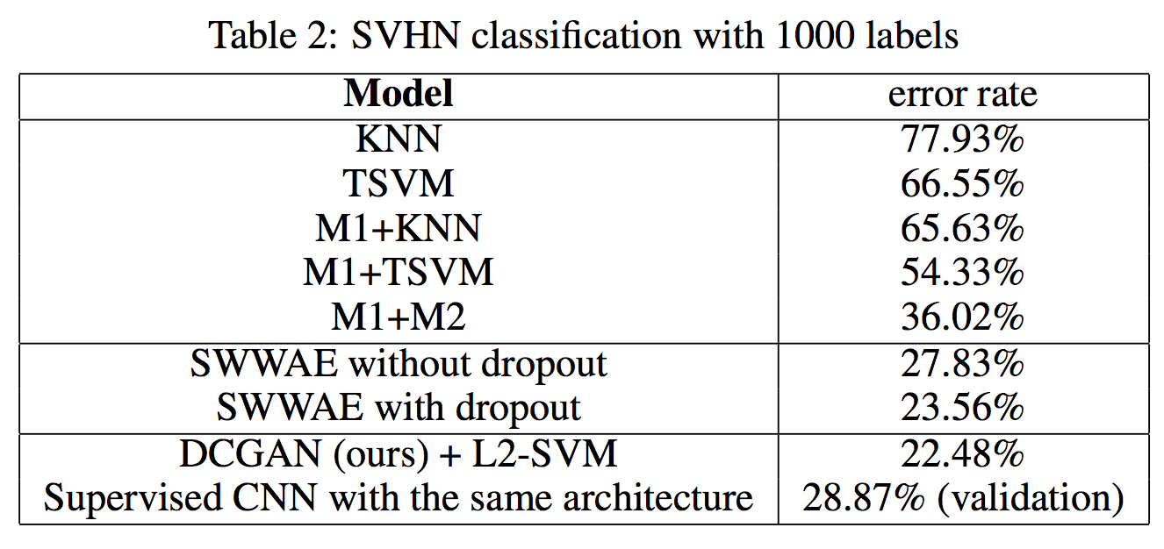
Notes:
On the StreetView House Numbers dataset (SVHN)(Netzer et al., 2011), we use the features of the discriminator of a DCGAN for supervised purposes when labeled data is scarce. Following similar dataset preparation rules as in the CIFAR-10 experiments, we split off a validation set of 10,000 examples from the non-extra set and use it for all hyperparameter and model selection. 1000 uniformly class distributed training examples are randomly selected and used to train a regularized linear L2-SVM classifier on top of the same feature extraction pipeline used for CIFAR-10. This achieves state of the art (for classification using 1000 labels) at 22.48% test error, improving upon another modifcation of CNNs designed to leverage unlabled data (Zhao et al., 2015). Additionally, we validate that the CNN architecture used in DCGAN is not the key contributing factor of the model’s performance by training a purely supervised CNN with the same architecture on the same data and optimizing this model via random search over 64 hyperparameter trials (Bergstra & Bengio, 2012). It achieves a signficantly higher 28.87% validation error.

Slide 14
Visualizing the “latent space”
No kind of nearest neighbor search on training set (pixel and feature spaces are trivially fooled by small images transforms)
Don’t use log-likelihood metrics to quantitatively assess the model

Slide 15
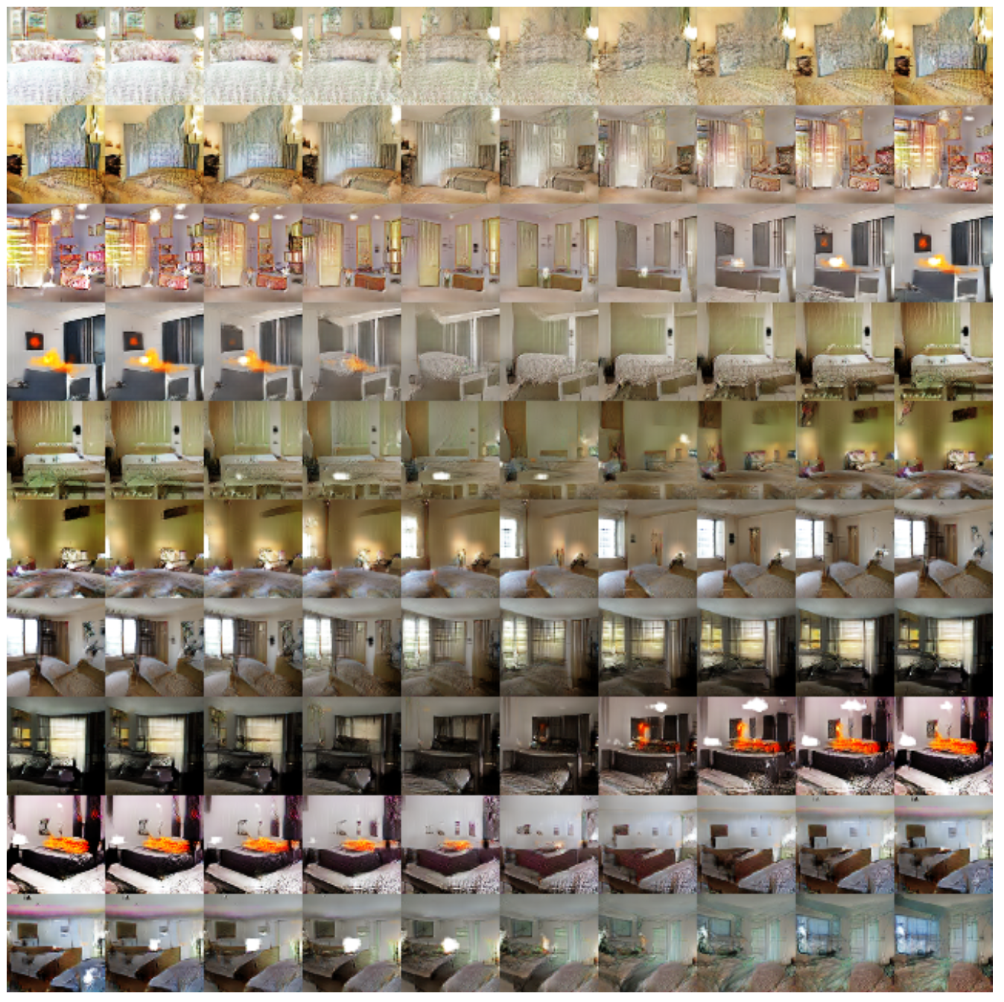
1: Walking the latent space
Notes:
The first experiment we did was to understand the landscape of the latent space
Walking on the manifold that is learnt can usually tell us about signs of memorization (if there are sharp transitions) and about the way in which the space is hierarchically collapsed
If walking in this latent space results in semantic changes to the image generations (such as objects being added and removed), we can reason that the model has learned relevant and interesting representations.

Slide 16
Notes:
Figure 4: Top rows: Interpolation between a series of 9 random points in Z show that the space learned has smooth transitions, with every image in the space plausibly looking like a bedroom. In the 6th row, you see a room without a window slowly transforming into a room with a giant window. In the 10th row, you see what appears to be a TV slowly being transformed into a window.

Slide 17
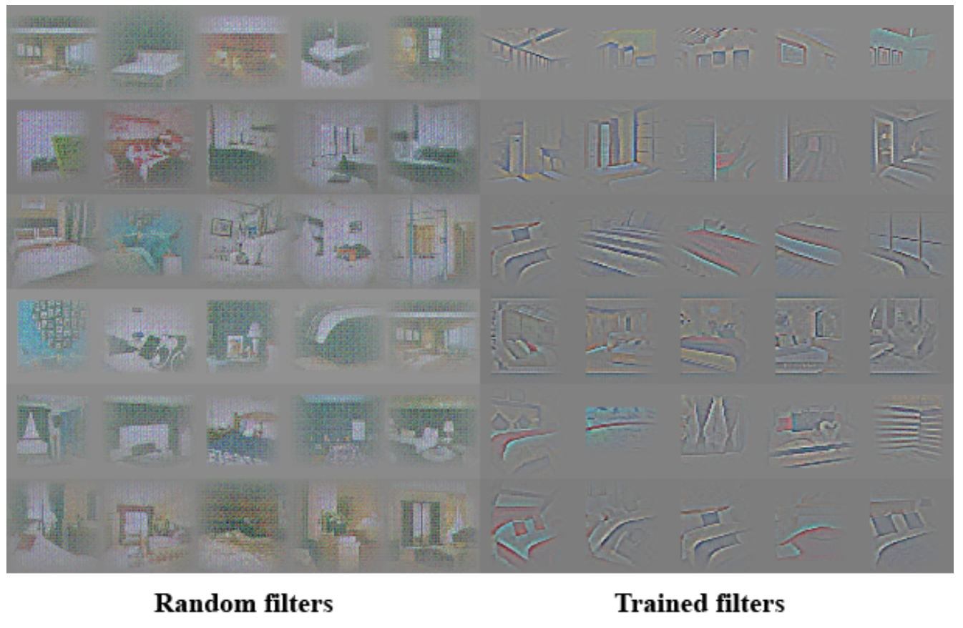
2: Visualizing Discriminator Features
Notes:
Previous work has demonstrated that supervised training of CNNs on large image datasets results in very powerful learned features (Zeiler & Fergus, 2014). Additionally, supervised CNNs trained on scene classification learn object detectors (Oquab et al., 2014). We demonstrate that an unsupervised DCGAN trained on a large image dataset can also learn a hierarchy of features that are interesting. Using guided backpropagation, we show that the features learnt by the discriminator activate on typical parts of a bedroom, like beds and windows. For comparison, in the same figure, we give a baseline for randomly initialized features that are not activated on anything that is semantically relevant or interesting.
Figure 5: On the right, guided backpropagation visualizations of maximal axis-aligned responses for the first 6 learned convolutional features from the last convolution layer in the discriminator. Notice a significant minority of features respond to beds - the central object in the LSUN bedrooms dataset. On the left is a random filter baseline. Comparing to the previous responses there is little to no discrimination and random structure.

Slide 18
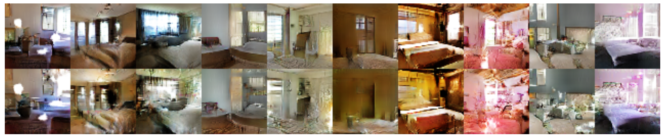
3: Manipulating Generator Representation
“Forgetting” to draw windows
Notes:
On 150 samples, 52 window bounding boxes were drawn manually. On the second highest con- volution layer features, logistic regression was fit to predict whether a feature activation was on a window (or not), by using the criterion that activations inside the drawn bounding boxes are posi- tives and random samples from the same images are negatives. Using this simple model, all feature maps with weights greater than zero ( 200 in total) were dropped from all spatial locations. Then, random new samples were generated with and without the feature map removal.
The generated images with and without the window dropout are shown in Fig.6, and interestingly, the network mostly forgets to draw windows in the bedrooms, replacing them with other objects.
Figure 6: Top row: un-modified samples from model. Bottom row: the same samples generated with dropping out ”window” filters. Some windows are removed, others are transformed into objects with similar visual appearance such as doors and mirrors. Although visual quality decreased, overall scene composition stayed similar, suggesting the generator has done a good job disentangling scene representation from object representation. Extended experiments could be done to remove other objects from the image and modify the objects the generator draws.

Slide 19
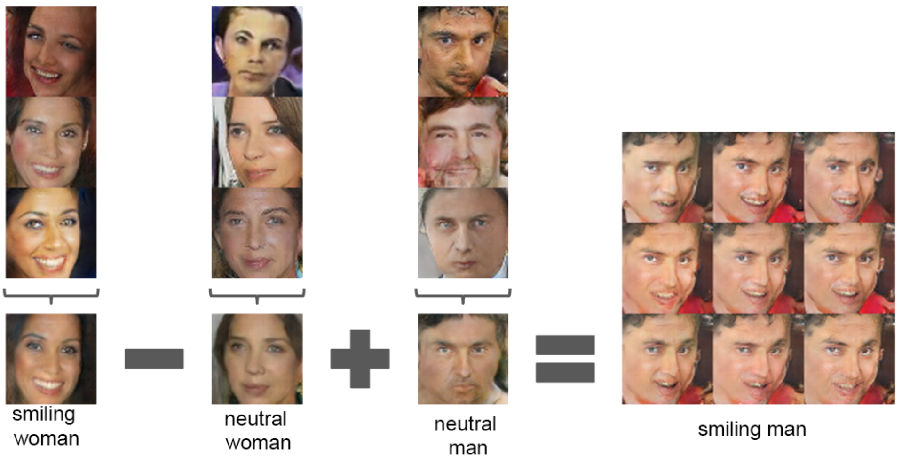
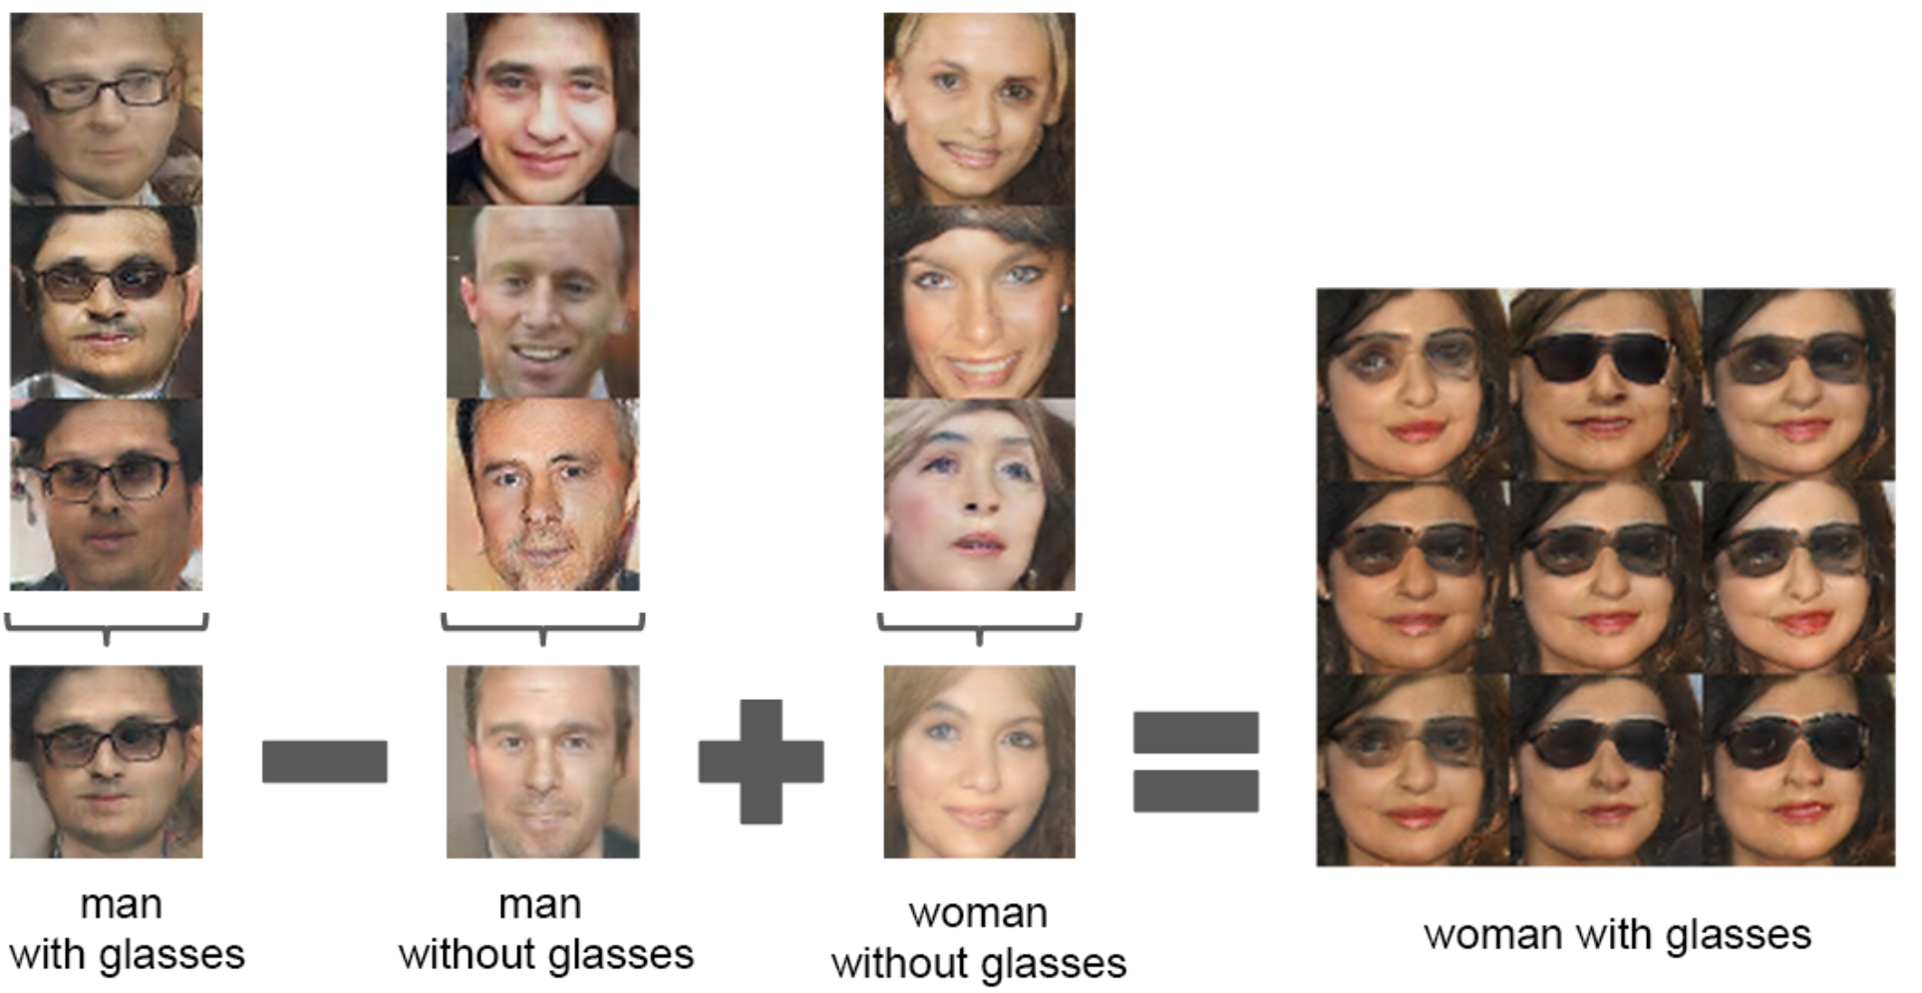
3: Manipulating Generator Representation
Vector arithmetic on faces
Notes:
We performed similar arithmetic on the Z vectors of sets of exemplar samples for visual concepts. Experiments working on only single samples per concept were unstable, but averaging the Z vector for three examplars showed consistent and stable generations that semantically obeyed the arithmetic. In addition to the object manipulation shown in (Fig. 7), we demonstrate that face pose is also modeled linearly in Z space (Fig. 8).
These demonstrations suggest interesting applications can be developed using Z representations learned by our models. It has been previously demonstrated that conditional generative models can learn to convincingly model object attributes like scale, rotation, and position (Dosovitskiy et al., 2014). This is to our knowledge the first demonstration of this occurring in purely unsupervised models. Further exploring and developing the above mentioned vector arithmetic could dramat- ically reduce the amount of data needed for conditional generative modeling of complex image distributions.
For each column, the Z vectors of samples are averaged. Arithmetic was then performed on the mean vectors creating a new vector Y . The center sample on the right hand side is produce by feeding Y as input to the generator. To demonstrate the interpolation capabilities of the generator, uniform noise sampled with scale +-0.25 was added to Y to produce the 8 other samples.

Slide 20
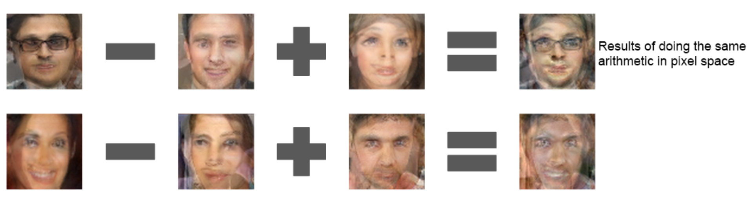
Notes:
Applying arithmetic in the input space (bottom two examples) results in noisy overlap due to misalignment.

Slide 21
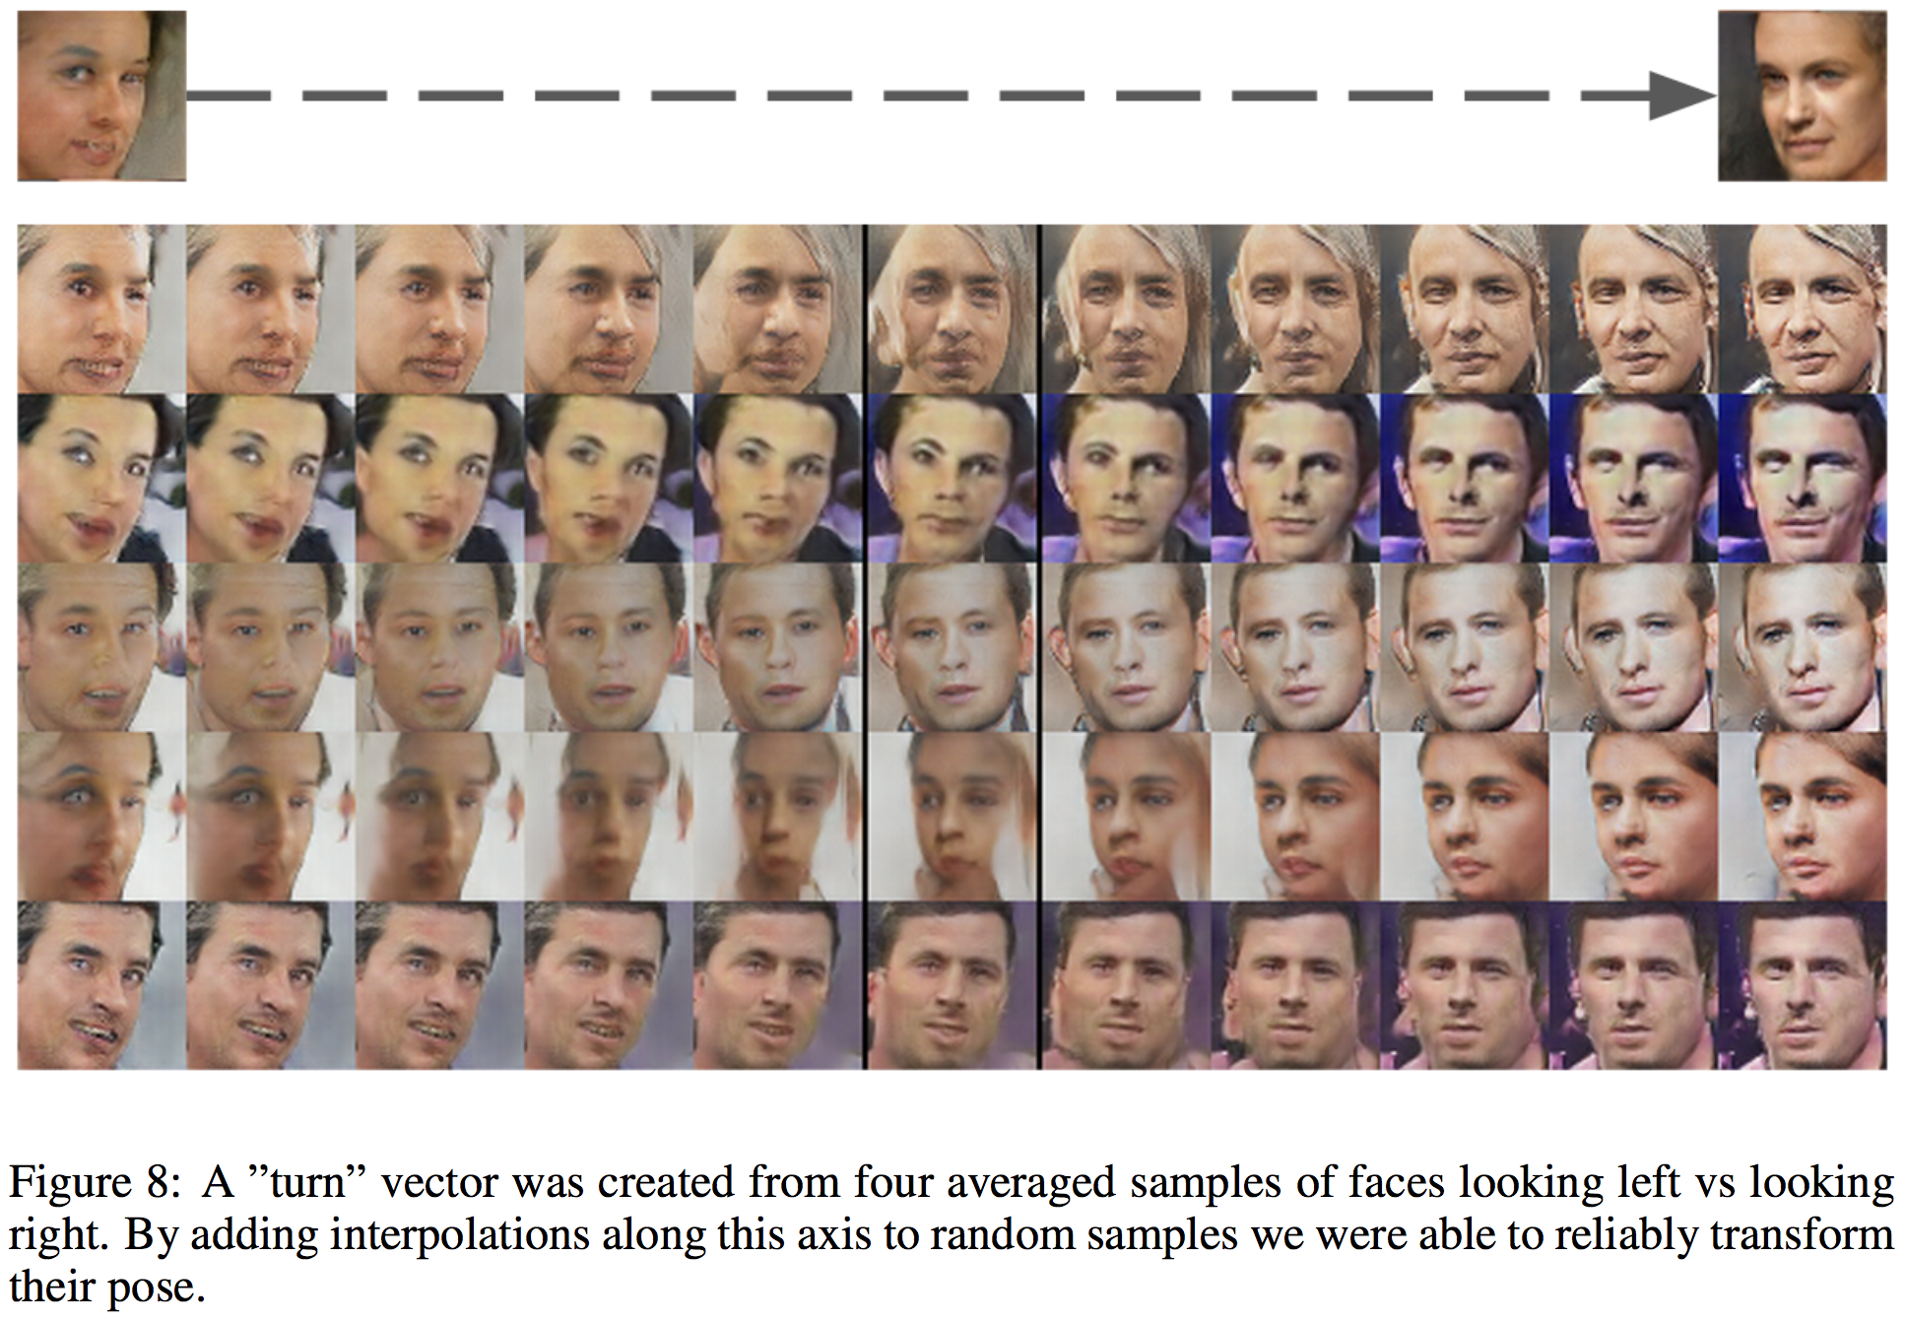
Notes:
A ”turn” vector was created from four averaged samples of faces looking left vs looking right
By adding interpolations along this axis to random samples we were able to reliably transform their pose.

Slide 22
Conclusions and Future Work
Proposed a more stable set of architectures for convolutional GANs
Still some remaining instability to be addressed
Longer training can result in collapse of subset of filters to single oscillating mode
Natural extensions for this work include video learning (e.g. frame prediction) and audio analysis (e.g. pre-trained features for speech synthesis)

Slide 23
References
Unsupervised Representation Learning with Deep Convolutional Generative Adversarial Networks: https://arxiv.org/abs/1511.06434
Generative Adversarial Networks: https://arxiv.org/abs/1406.2661
Striving for Simplicity: The All Convolutional Net: https://arxiv.org/abs/1412.6806

